Slide 1
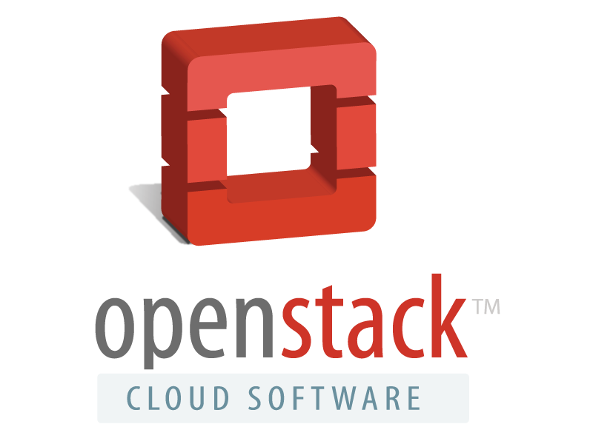
OpenStack
Ani Bicaku

Slide 2
What is OpenStack ?
Open-Source Cloud OS
Public and Private Cloud
18000 individual members
140 countries around the world
Collection of open-source technologies

Slide 3
Why OpenStack ?
Research of assurance in Cloud environment
Monitor Cloud infrastructure
Testbed
Investigate open-source monitoring tools
Harmonize different monitoring tools

Slide 4
What can you do with OpenStack
Virtual Servers
Virtual network and virtual data center
Scalable servers
Load balancing
Virtual Storage
Billing
Migrate data and applications
Disaster recovery

Slide 5
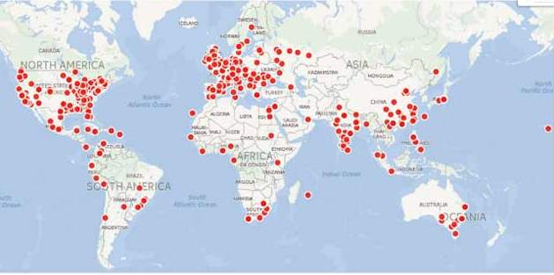
OpenStack Principles
Open Development
Open Design
Open Community

Slide 6
OpenStack is Cloud OS
User
Your Application
APIs
Dashboard
Hypervisor
Hardware

Slide 7
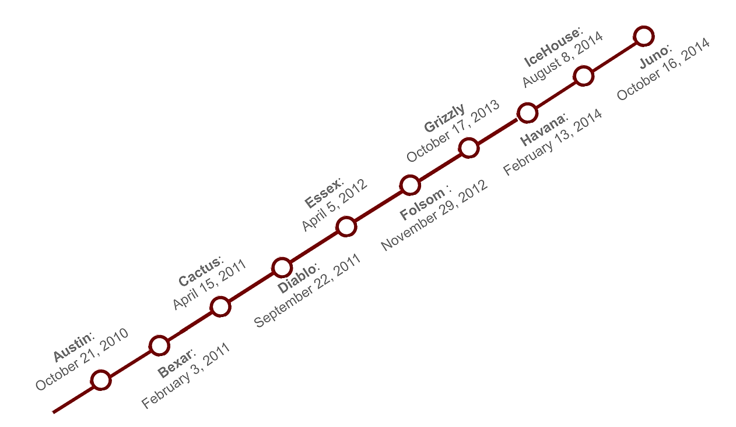
OpenStack Release

Slide 8
Simplified OpenStack Component Interaction
Dashboard
(HORIZON)
User Interface
Keystone : Authentication and authorization framework
Neutron: Provide network as a service to compute
Nova : Provision and manage virtual networks for VM’s
Glance : Registry for VMs image
Horizon : Web Interface to manage instances
Networking
(NEUTRON)
Compute
(NOVA)
Image
(GLANCE)
Identity
(KEYSTONE)
Authentication
Stores Images

Slide 9
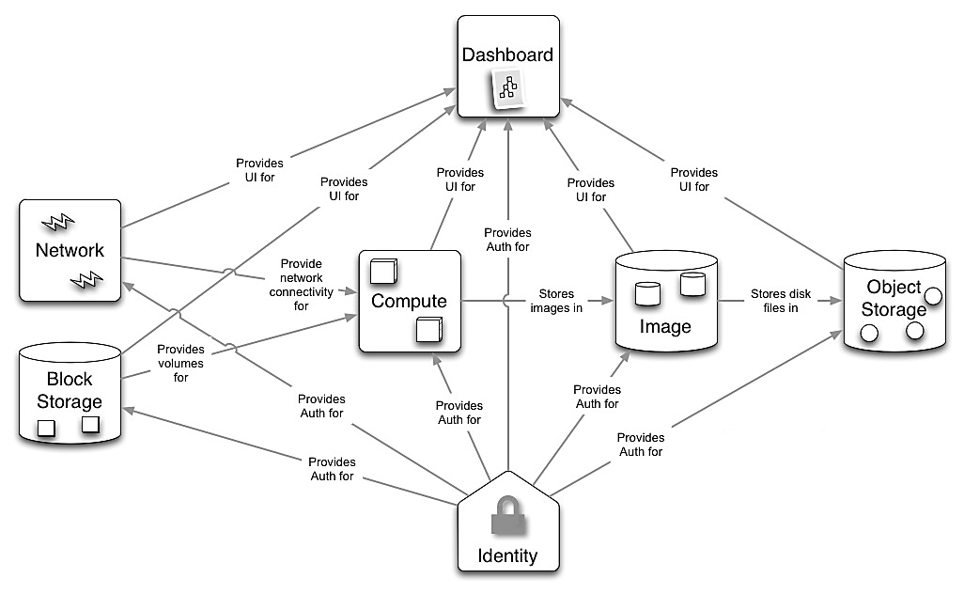
OpenStack Service Relation
Horizon
Neutron
Nova
Glance
Swift
Cinder
Keystone

Slide 10
OpenStack Optional Services
Orchestration Service
Load Balancer as a Service
Telemetry Service
Database as Service

Slide 11
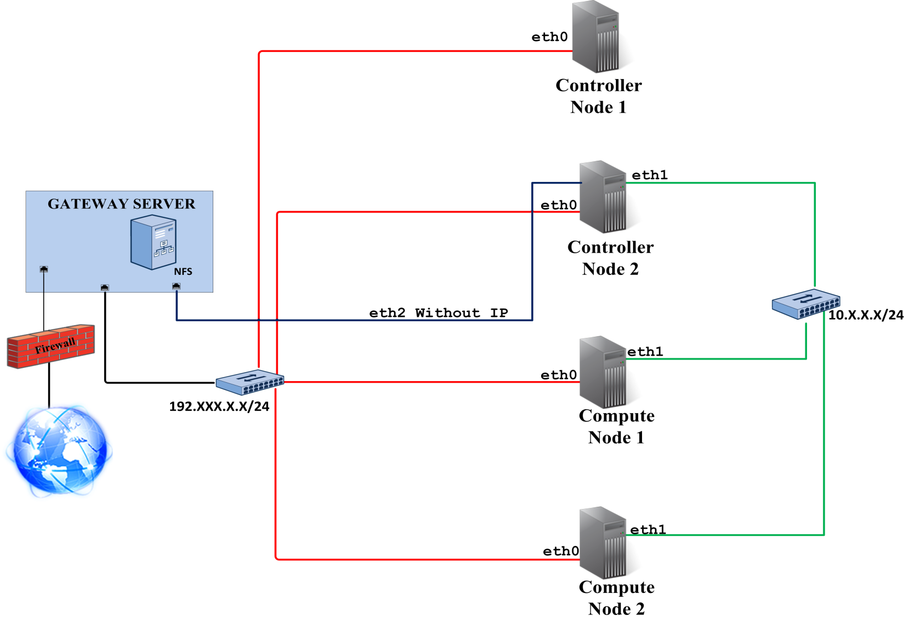
Running example
Main server
Keystone
Glance
Nova
Cinder
Heat
Ceilometer
Network controller
Neutron
Horizon
Lbaas
Compute 1 / 2
Nova-compute
Neutron-compute
Ceilometer-agent
Network eth0 - Administration Network
Network eth1 - Instance Tunneling Network
Network eth2 - Public Network for VMs

Slide 12
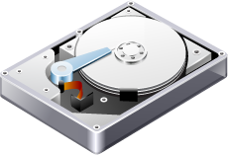
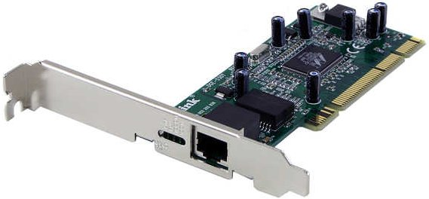
Technical Requirements
Server (3 machines)
CPU supporting Hypervisor KVM & 64-bit x86
4 GB RAM
160 GB HDD
Operating System
Ubuntu Server 14.04 LTS 64-bit
Network Configuration
NIC Gigabit

Slide 13
Launch an Instance from Horizon

Slide 14
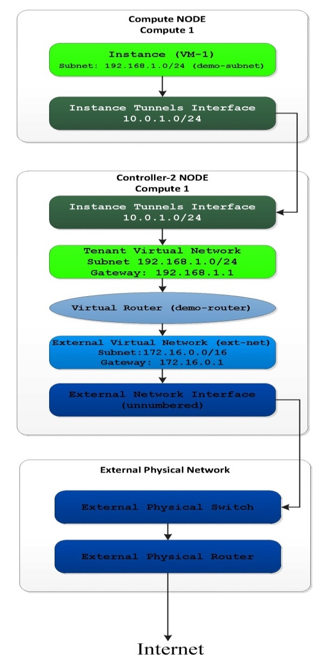
Virtual Network Infrastructure
External Network provides external internet access for instances.
Tenant network provides internal network access for instances
Virtual router passes network traffic between two or more virtual networks
To enable internet access to individual instances they need floating IP and security group rules.

Slide 15
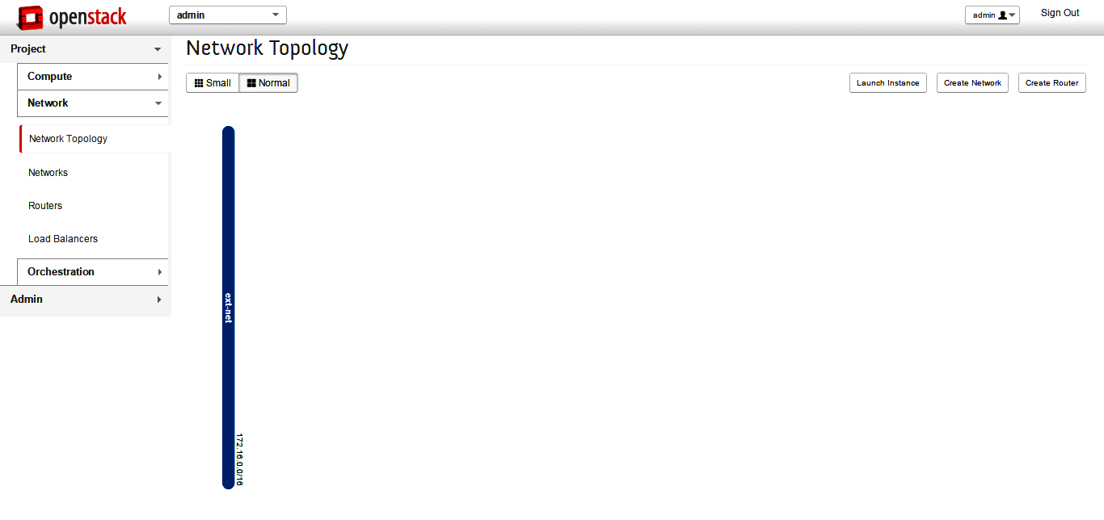
Initial Network
Create the external network
Internet access from instances
Create a subnet on external network
Like a physical network, a virtual network requires a subnet assigned to it

Slide 16
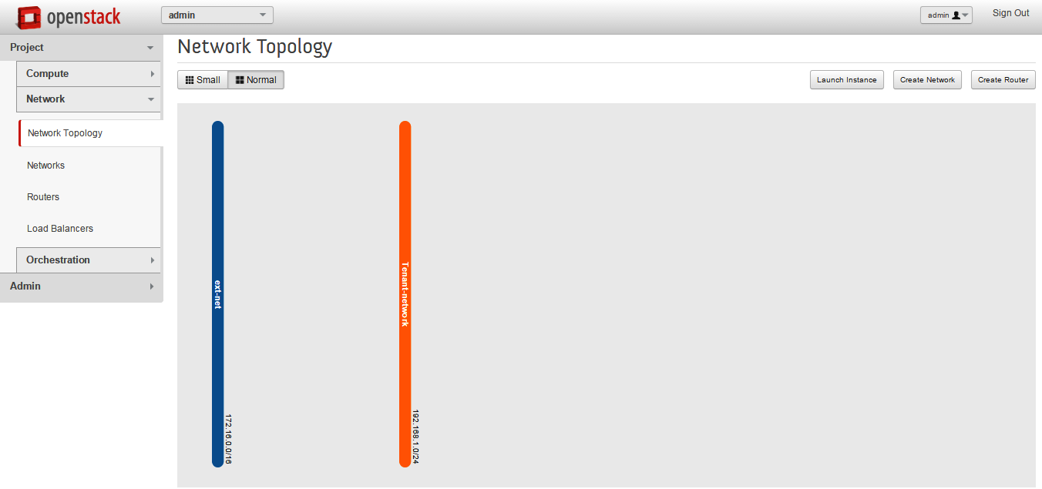
Initial Network
Create the tenant network
Provides internal network access for instances
Create a subnet on the tenant network
Like the external network , the tenant network requires a subnet attached to it

Slide 17
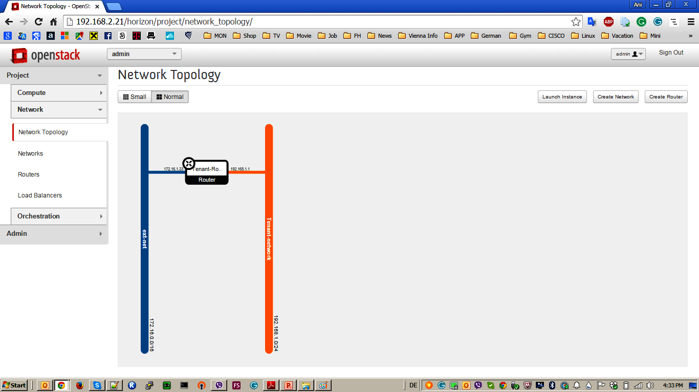
Initial Network
Create the router
Router connected with tenant and external network
Attach the Router to the tenant network
Attach the Router to the external network

Slide 18
VM Provisioning
User has an access to Horizon or CLI
Nova-compute take information for VM from DB, creates a coomand to hypervisor and delegates VM rendering to hypervisor
Hypervisor downloads image using URL given by Glance
Neutron-network update tables with networking info and VM entry DB
Nova-api sends HTTP request to validate token to
Keystone
Keystone validate API token and send response with accept/reject info
User specify VM parameters (flavor,image,key)
Click “Create” buton
Horizon sends HTTP request to Keystone
Keystone sends back temporary token to Horizon via HTTP
Horizon sends POST request to nova-api
(signed with given token)
Nova-api validate it from nova-db.If request is valid it saves a db entry about the new VM
Nova api publishes a short message to scheduler with VM info
Scheduler sends the message to nova-compute
Nova-compute take information for VM from DB, creates a coomand to hypervisor and delegates VM rendering to hypervisor
Hypervisor request VM image from Glance via image ID
Nova-compute request from neutron-network networking info
Horizon
Horizon
CLI
CLI
Controller 1
Keystone
Glance
Nova-api
Endpoint
Nova-api
Endpoint
Glance-api
Glance-api
Nova DB
Glance-registry
Scheduler
Nova DB
Scheduler
Nova Compute
Nova-compute
Nova-compute
Neutron
Neutron-network
Neutron-network
Hypervisor
Hypervisor

Slide 19
VM Provisioning
Tenant is created, user has an access to Horizon / CLI
Horizon
CLI
Controller 1
Keystone
Glance
Nova-api
Endpoint
Glance-api
Nova DB
Glance-registry
Scheduler
Nova Compute
Nova-compute
Neutron
Neutron-network
Hypervisor

Slide 20
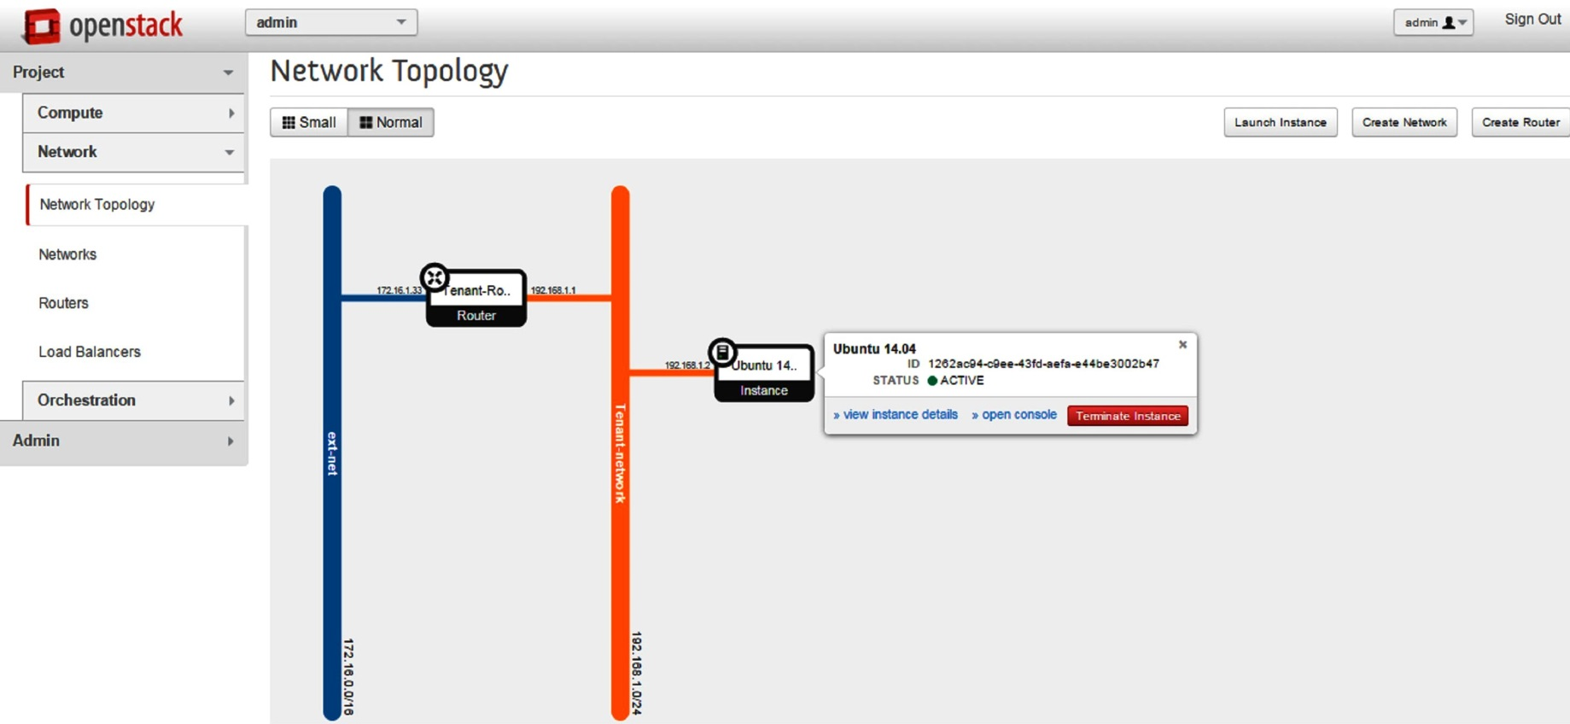
Create Instance
Name
Flavor (Tiny / Small / Medium / Large / Xlarge)
Instance Boot Source (Image/ SnapShot/ Volume )
Key Pair
Networking

Slide 21
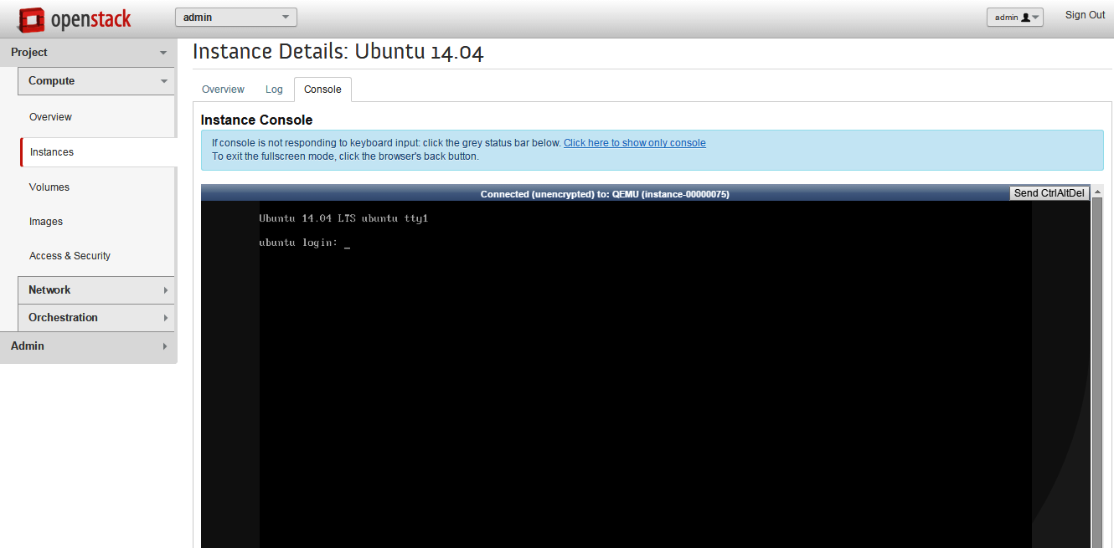
Instance Console

Slide 22
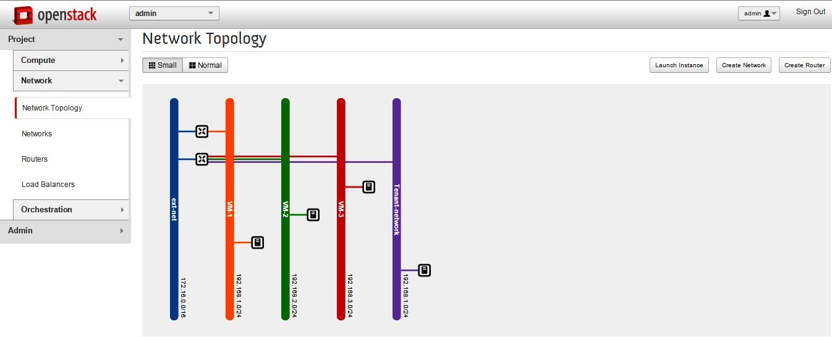
Network Topology

Slide 23
Open-Source Monitoring Tools

Slide 24
Get involved!
Website: www.openstack.org
Mailing Lists: http://lists.openstack.org
Wiki: http://wiki.openstack.org

Slide 25
Contact
Ani Bicaku
AIT
0043 660 28 37 355
Ani.Bicaku@ait.ac.at

